Slide 1
Changes to Academic Advising
After reviewing the practices at other institutions and FERPA regulations, the Council of Deans decided the following:
Faculty will be given access to all student records
This information will support faculty as they fulfill mentoring roles
The access will be constrained by FERPA regulations
Access is limited to work internal to the university’s operations
Each student will have a single academic advisor of record

Slide 2
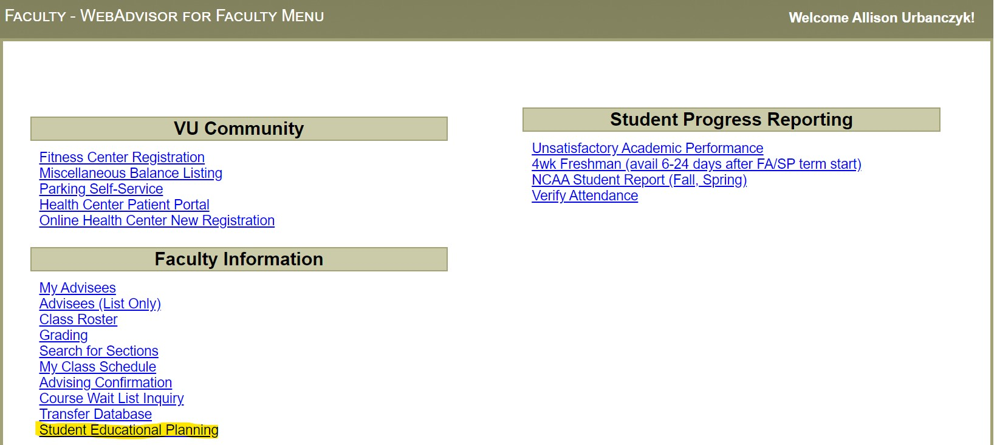
Student Educational Planning

Slide 3
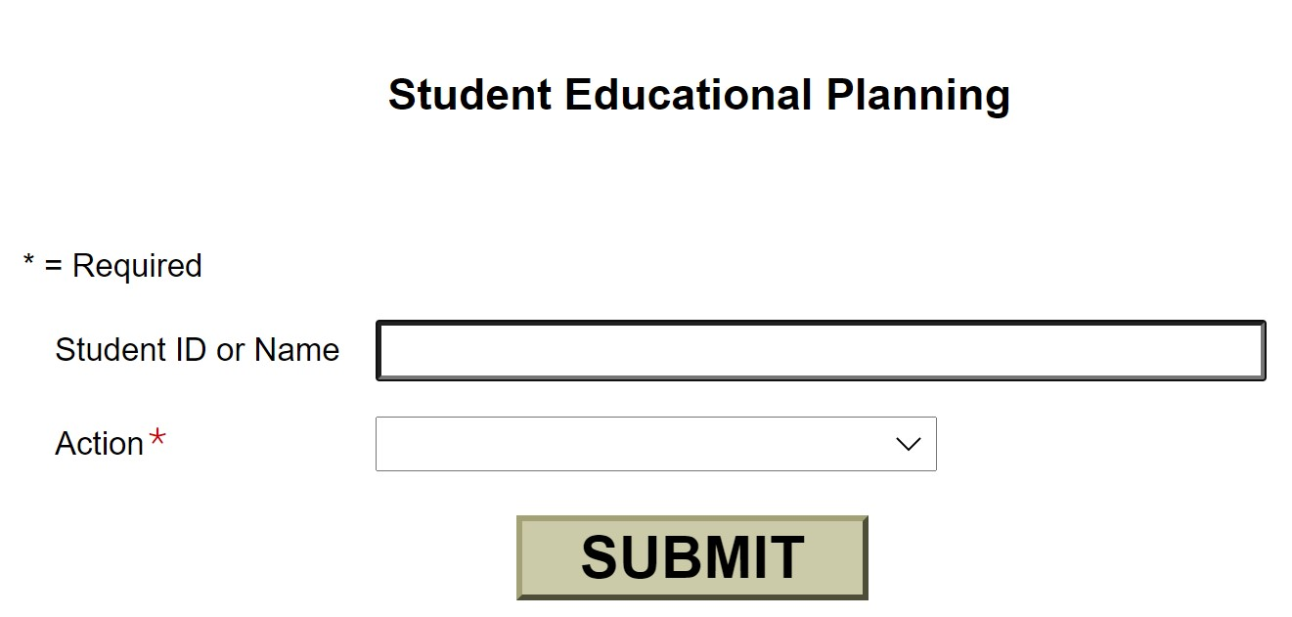
Student Educational Planning
Enter a student ID number or name
Select an Action

Slide 4
Student Educational Planning
Test Summary
Schedule
Evaluate Program (Degree Audit)
Transcript

Slide 5
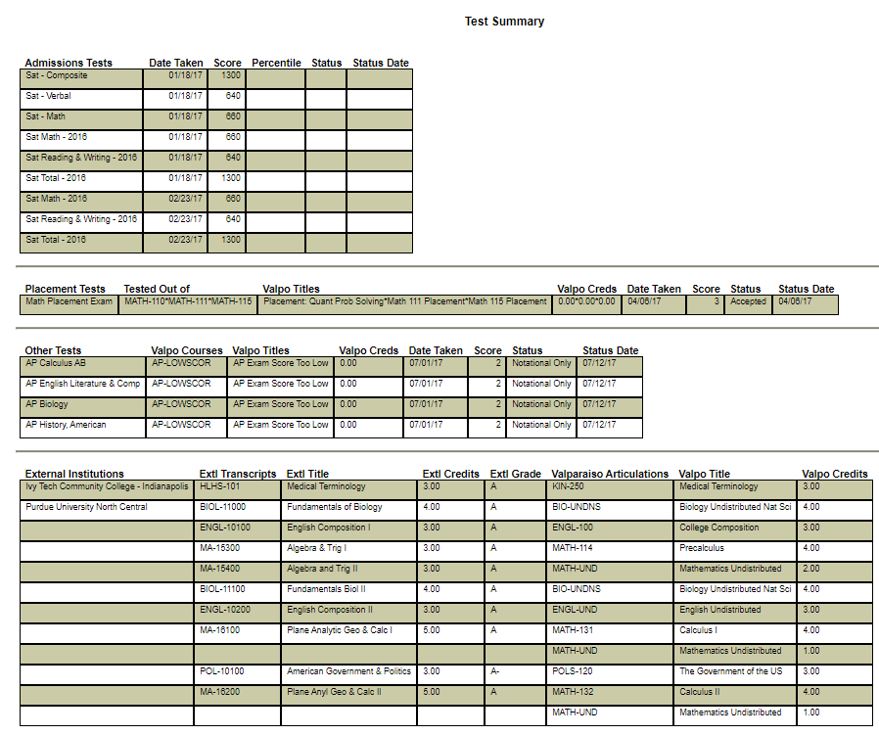
Student Test Summary
Review test scores and credit awarded
Admission tests, such as ACT or SAT
Placements tests, such as Math and World Languages
Other tests, such as Advanced Placement (AP)
Transfer credit earned at other institutions

Slide 6
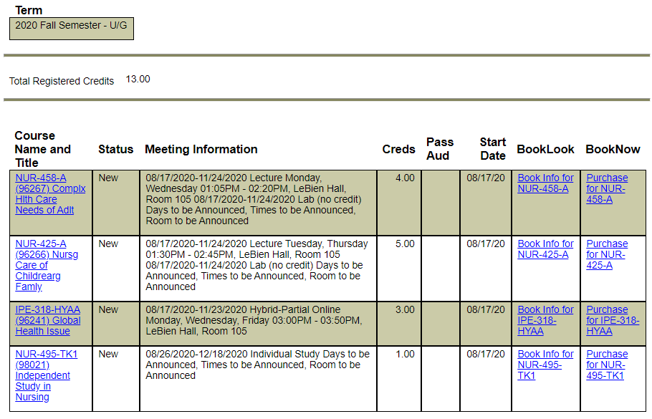
Student Schedule
Specify the student and the term to view the schedule details
Course Name and Title
Meeting Information
Credits
Book

Slide 7
Evaluate Program (Degree Audit)
The Academic Evaluation report, also called a Program Evaluation or Degree Audit, includes
A summary of overall and major GPAs and credits completed
Program requirements by category, and the student's progress in completing them
Review a student's progress – Active Program
Also allows 'what-if' planning to view how the student's completed credits would be applied to a new program if they changed their major using the Curriculum Change eForm.
Notes:
Office of the Registrar is working to expand the university’s Knowledge Base.
We will soon add articles to support academic advisors, including a guide for using the degree audit.

Slide 8
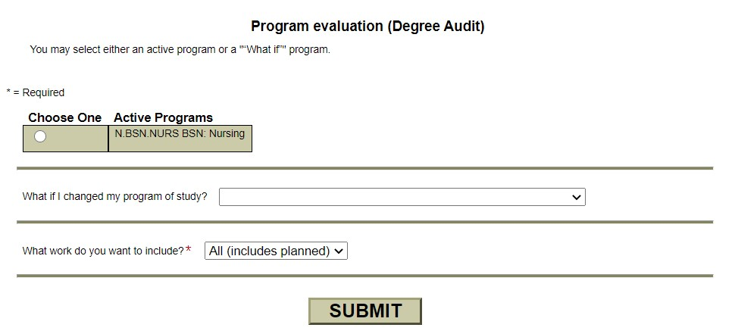
Evaluate Program (Degree Audit)

Slide 9
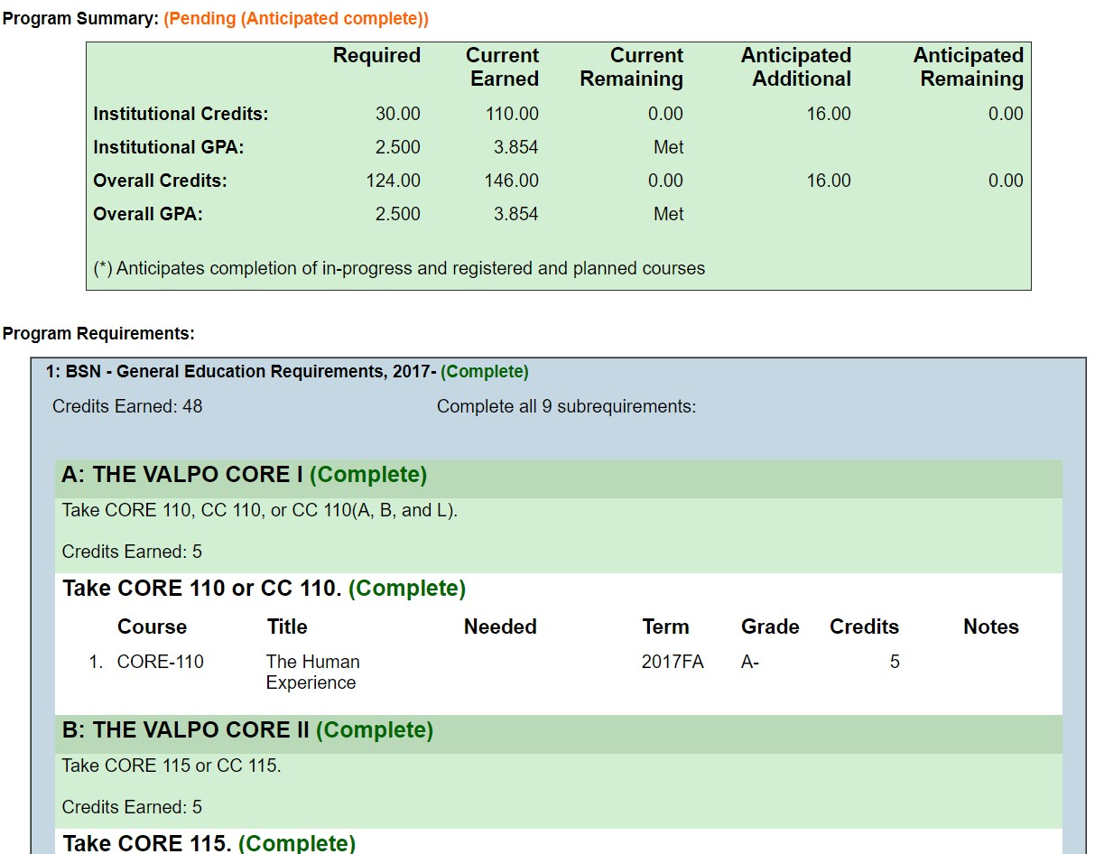
Evaluate Program (Degree Audit)
Overall Credits & GPA
General Education
Major(s)
Minor(s)
Programmed based on requirements in the Catalog
Notes:
The information on the degree audit is summarized and sent via email to students who have applied for graduation before the start of their final semester, giving them the opportunity to add any missing courses and complete the degree on time.
Weekly emails are sent to academic advisors sharing a list of their advisees who have applied for graduation. There is a column dedicated to whether they have unmet degree requirements yet to resolve. This helps advisors to quickly identify students in need of additional advising support.

Slide 10
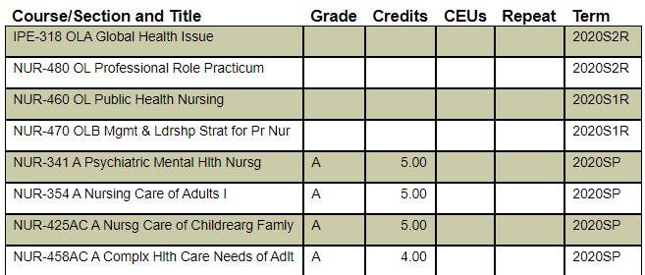
Student Transcript
Review a student's academic course record, including courses completed at Valpo, credit awarded as advanced placement, and recorded transfer credit
Specify a Transcript Type to narrow for Graduate, Undergraduate, or Law
This is NOT an official transcript and should not be provided to a student or outside entity as such. Students place transcript orders through DataVU. They are delivered by our vendor, Parchment.

Slide 11
FERPA Training
Please remember that much of this information is protected under FERPA and should only be accessed for the purpose of assisting a student in their academic planning.
Online Family Educational Rights and Privacy Act (FERPA) Training https://valpo-in.safecolleges.com/login
FERPA Statement http://www.valpo.edu/general-counsel/policies/policies-related-to-faculty-and-staff

Slide 12
Verification Services
Please refer all requests for Verification Services to the Office of the Registrar. Other employees may not provide letters or complete forms regarding enrollment, GPA, or other information from the academic record.

Slide 13
Resources
“Changes to the Advising System Beginning Fall 2020” www.valpo.edu/news/2020/03/25/changes-to-the-advising-system-beginning-fall-2020
Help Article in Confluence: “Student Educational Planning Menu in DataVU” https://confluence.valpo.edu/display/ITKB/Student+Educational+Planning+menu+in+DataVU
Online Family Educational Rights and Privacy Act (FERPA) Training https://valpo-in.safecolleges.com/login
FERPA Statement www.valpo.edu/general-counsel/policies/policies-related-to-faculty-and-staff

